Slide 1


Cloud Computing Credit Hours: 4 Hrs. Lecture 1
Texas College of Management & IT
BIT 6th Semester
Saroj Dhital
22nd November, 2021

Slide 2
Unit 1: Introduction
The emergence of Cloud Computing
Cloud-Based Services
Grid computing or Cloud Computing
Components of Cloud Computing
Virtualization
Cloud Computing Deployment Models
Benefit of using Cloud Model
Legal Issues in Using Cloud Models
Characteristics of Cloud Computing
Evolution of Cloud Computing
Challenges for the Cloud Computing
Grid Computing
Distributed Computing in Grid and Cloud
Cloud Computing

Slide 3
1.1 Introduction
Cloud computing is the use of computing resources (hardware and software) that are delivered as a service over a network (typically the Internet).
The name comes from the use of a cloud-shaped symbol as an abstraction for the complex infrastructure it contains in system diagrams.
Cloud computing entrusts remote services with a user's data, software and computation.
Cloud computing is a general term for anything that involves delivering hosted services over the Internet. These services are broadly divided into three categories: Infrastructure-as-a-Service (IaaS), Platform-as-a-Service (PaaS) and Software-as-a- Service (SaaS).
The name cloud computing was inspired by the cloud symbol that's often used to represent the Internet in flowcharts and diagrams.
Cloud Computing

Slide 4
1.1 Introduction
A cloud service has three distinct characteristics that differentiate it from traditional hosting.
It is sold on demand, typically by the minute or the hour;
It is elastic -- a user can have as much or as little of a service as they want at any given time; and
The service is fully managed by the provider (the consumer needs nothing but a personal computer and Internet access). Significant innovations in virtualization and distributed computing, as well as improved access to high-speed Internet and a weak economy, have accelerated interest in cloud computing.
Why Cloud Computing?
Cloud Computing

Slide 5
1.2 The emergence of Cloud Computing
Small as well as large IT companies, follow the traditional methods to provide the IT infrastructure. That means for any IT company, we need a Server Room that is the basic need of IT companies.
In that server room, there should be a database server, mail server, networking, firewalls, routers, modem, switches, QPS (Query Per Second means how much queries or load will be handled by the server), configurable system, high net speed, and the maintenance engineers.
To establish such IT infrastructure, we need to spend lots of money. To overcome all these problems and to reduce the IT infrastructure cost, Cloud Computing comes into existence.
Cloud Computing

Slide 6
1.3 Characteristics of Cloud Computing
Characteristics of Cloud Computing
Agility - works in a distributed computing environment (remember agile methodology in SDLC)
High availability and reliability - chances of infrastructure failure are minimum
High Scalability - "on-demand" provisioning of resources on a large scale
Multi-Sharing - multiple users and applications can work more efficiently
Device and Location Independence - As infrastructure is off-site (typically provided by a third-party) and accessed via the Internet, users can connect from anywhere.
Maintenance - do not need to be installed on each user's computer and can be accessed from different places
Low Cost - IT company need not to set its own infrastructure
Services in the pay-per-use mode - Application Programming Interfaces (APIs) are provided to the users so that they can access services on the cloud by using these APIs and pay the charges as per the usage of services.
Cloud Computing

Slide 7
1.4 Advantages of Cloud Computing
Advantages of Cloud Computing
Back-up and Data Restoring
Improved Collaboration
Excellent Accessibility
Low Maintenance Cost
Mobility
API Services in the Pay-Per-Use Model
Unlimited Storage Capacity
Data Security
Cloud Computing

Slide 8
1.5 Disadvantages of Cloud Computing
Disadvantages of Cloud Computing
Internet Connectivity
Vendor Lock-In
Limited Control
Security
Cloud Computing

Slide 9
1.6 Components of Cloud Computing
Components of Cloud Computing
Client Infrastructure
Application
Service
IaaS
Saas
PaaS
Runtime Cloud
Storage
Datacenters
Distributed Servers
Internet
Cloud Computing

Slide 10
1.7 Grid Computing
Grid Computing can be defined as a network of computers working together to perform a task that would rather be difficult for a single machine.
All machines on that network work under the same protocol to act like a virtual supercomputer.
The task that they work on may include analyzing huge datasets or simulating situations which require high computing power.
Computers on the network contribute resources like processing power and storage capacity to the network.
Grid Computing is a subset of distributed computing, where a virtual super computer comprises of machines on a network connected by some bus, mostly Ethernet or sometimes the Internet.
It can also be seen as a form of Parallel Computing where instead of many CPU cores on a single machine, it contains multiple cores spread across various locations.
The concept of grid computing isn’t new, but it is not yet perfected as there are no standard rules and protocols established and accepted by people.
Cloud Computing

Slide 11
1.7 Grid Computing - Components
Control Node:
A computer, usually a server or a group of servers which administrates the whole network and keeps the account of the resources in the network pool.
Provider:
The computer which contributes it’s resources in the network resource pool.
User:
The computer that uses the resources on the network.
Cloud Computing

Slide 12
1.8 Virtualization
Virtualization is the creation of a virtual -- rather than actual -- version of something, such as an operating system (OS), a server, a storage device or network resources.
Virtualization uses software that simulates hardware functionality to create a virtual system.
This practice allows IT organizations to operate multiple operating systems, more than one virtual system and various applications on a single server.
The benefits of virtualization include greater efficiencies and economies of scale.
The machine on which the virtual machine is going to create is known as Host Machine and that virtual machine is referred as a Guest Machine.
Cloud Computing

Slide 13
1.8 Virtualization - Types
Hardware Virtualization
When the virtual machine software or virtual machine manager (VMM) is directly installed on the hardware system is known as hardware virtualization.
Hardware virtualization is mainly done for the server platforms, because controlling virtual machines is much easier than controlling a physical server.
Operating system Virtualization
When the virtual machine software or virtual machine manager (VMM) is installed on the Host operating system instead of directly on the hardware system is known as operating system virtualization.
Operating System Virtualization is mainly used for testing the applications on different platforms of OS.
Cloud Computing

Slide 14
1.8 Virtualization - Types
Server Virtualization
When the virtual machine software or virtual machine manager (VMM) is directly installed on the Server system is known as server virtualization.
Server virtualization is done because a single physical server can be divided into multiple servers on the demand basis and for balancing the load.
Storage Virtualization
Storage virtualization is the process of grouping the physical storage from multiple network storage devices so that it looks like a single storage device.
Storage virtualization is also implemented by using software applications.
Storage virtualization is mainly done for back-up and recovery purposes.
Cloud Computing

Slide 15
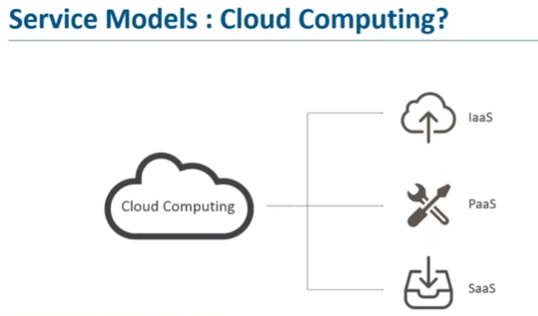
1.9 Cloud Based Services
Cloud Computing

Slide 16
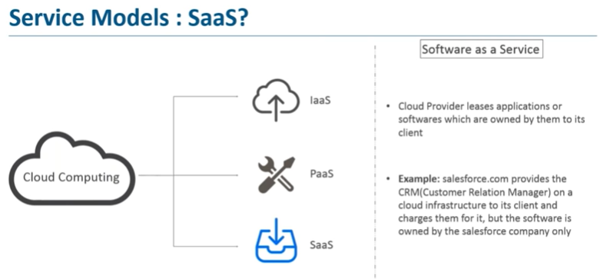
1.9 Cloud Based Services
Cloud Computing

Slide 17
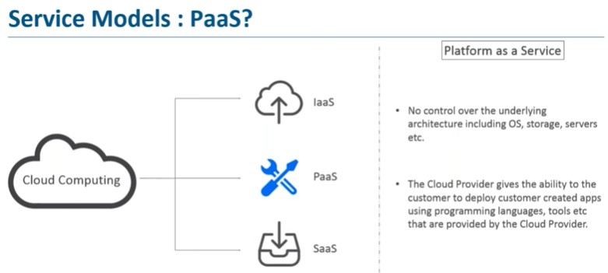
1.9 Cloud Based Services
Cloud Computing

Slide 18
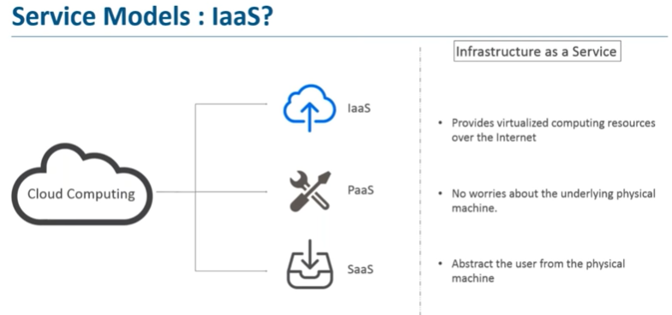
1.9 Cloud Based Services
Cloud Computing

Slide 19
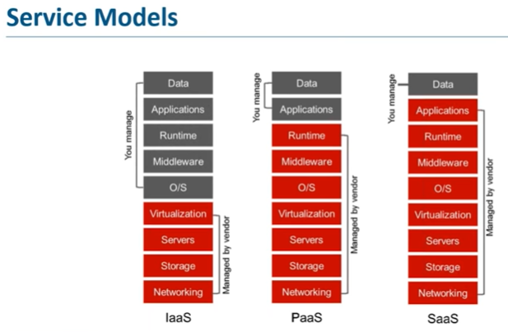
1.9 Cloud Based Services
Cloud Computing

Slide 20
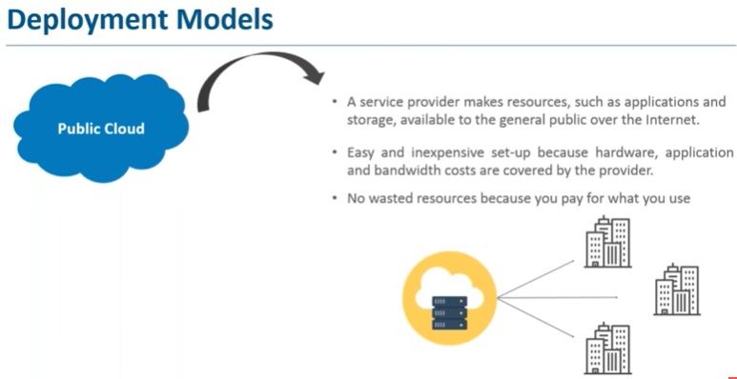
1.10 Cloud Deployment Model
Cloud Computing

Slide 21
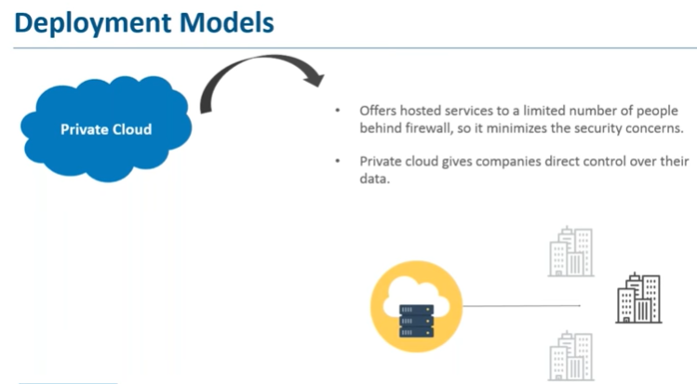
1.10 Cloud Deployment Model
Cloud Computing

Slide 22
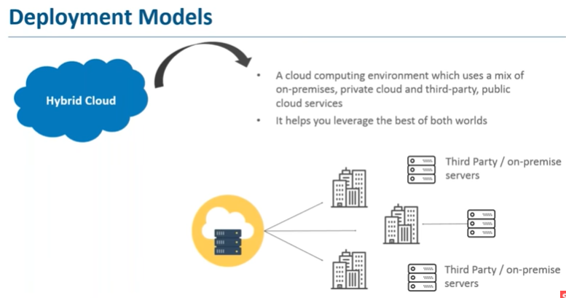
1.10 Cloud Deployment Model
Cloud Computing

Slide 23
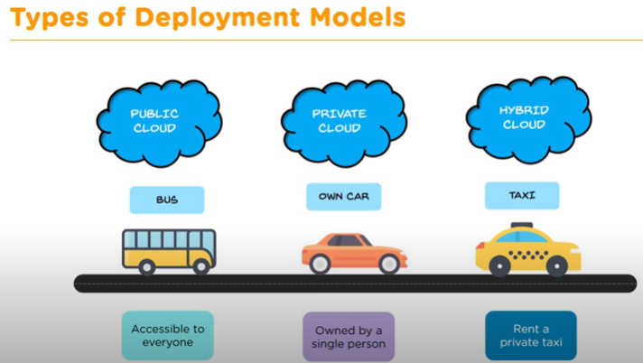
1.10 Cloud Deployment Model
Cloud Computing

Slide 24
1.10 Cloud Deployment Model
Cloud Computing

